Slide 1
AI Chatbot for Students Assistance
Under Supervision of Professor Kevin Kelly
Shirish Senthil Kumar
AI Chatbot for Students Assistance
Date 02/03/2023

Slide 2
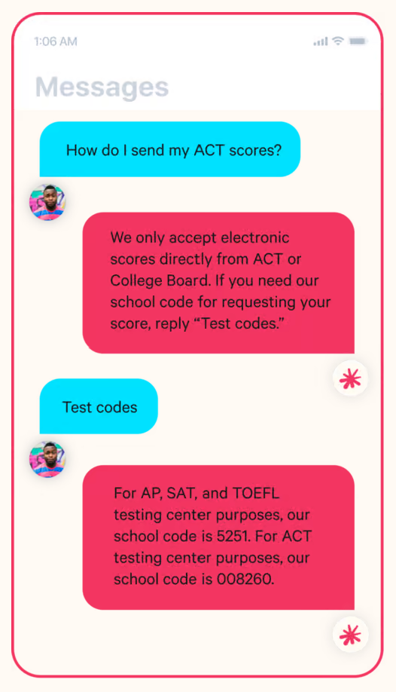
Introduction
Introduction
Python Prototyping
Feasibility Study
Google Dialogflow
Benchmarking & Future Work
23% of customer service companies are currently using AI chatbots, demand to increase
Notable educational institutions integrating this technology are Deakin University, Georgia State and other prominent US universities
Rise in AI tech such as ChatGPT has increased interest amongst prospective students, Trinity can set a standard
Georgia State’s Pounce virtual assistant

Slide 3
Problem Statement
Introduction
Python Prototyping
Feasibility Study
Google Dialogflow
Benchmarking & Future Work
To build a robust AI Chatbot for students assistance that shows quick and accurate responses, contextual awareness (NLP), positive user experience and Human Parity
Project RoadMap
Feasibility Study
Research Proposal
Development & Integration
Testing & Benchmarking

Slide 4
Key Stakeholders
Introduction
Python Prototyping
Feasibility Study
Google Dialogflow
Benchmarking & Future Work
Current and Prospective Students
School Officers
Professors and Head of Departments

Slide 5
Key Takeaways from Stakeholder Research
Introduction
Python Prototyping
Feasibility Study
Google Dialogflow
Benchmarking & Future Work
Students
Difficulty in Information Access
Long Response Times
Professors
Misinterpretation of Queries
Busy Academic Schedule
Impersonal Emails
Redundant Questions
School Office
Busy Schedule
Redundant Questions
Missing Emails

Slide 6




Introduction
Python Prototyping
Feasibility Study
Google Dialogflow
Benchmarking & Future Work
SWOT ANALYSIS of the AI Chatbot
24/7 Availability
Faster response times
Scalability
Interactive features for UI/UX
Lack of Emotional Intelligence
Complex questions​
Technical Issues​
Improved Student Experience​
Opportunity to Innovate​
Reduced redundancy.
Security and Privacy Concerns​
Cost of Implementation.

Slide 7
Introduction
Python Prototyping
Feasibility Study
Google Dialogflow
Benchmarking & Future Work
Key Definitions of the AI Chatbot
Intent recognition: Using Natural language processing to associate text data and expression to an intent
Entities: Entities can be fields, data, or text describing just about anything — courses, PhD’s, etc
Contexts: Allows developers to control the order of intent matching
Training Phrases: Example phrases for what end-users might type or say, referred to as end-user expressions
Knowledge Base: Represents a collection of knowledge documents. It is created and curated using the Python prototype chatbot

Slide 8
Introduction
Python Prototyping
Feasibility Study
Google Dialogflow
Benchmarking & Future Work
Initial Python Prototype (FAQ)
Hard-code a third-party tool (Google Dialogflow) to get a better understanding of the NLU processes
Use the prototype to curate knowledge base and integrate with Dialogflow as a JSON/.csv file
Basic concept: If it works in the basic NLU, it will work on Google’s powerful NLU engine
Input Query
Data Processing
Feature Extraction
Deep Learning Model
Response Generator
Output Response
Text
Pre-processed Text
Bag of Words
Intents JSON
Pre Defined Responses

Slide 9
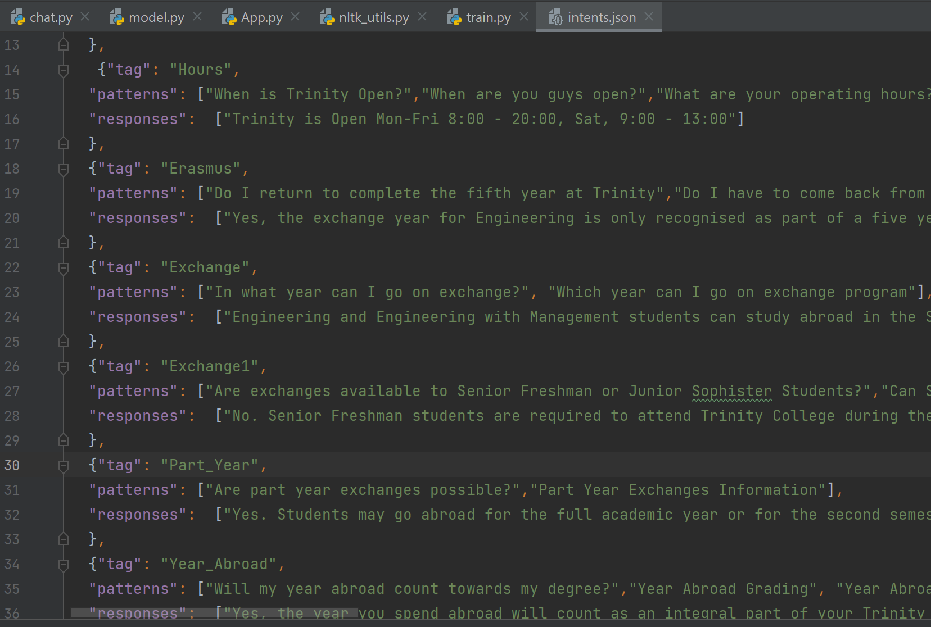
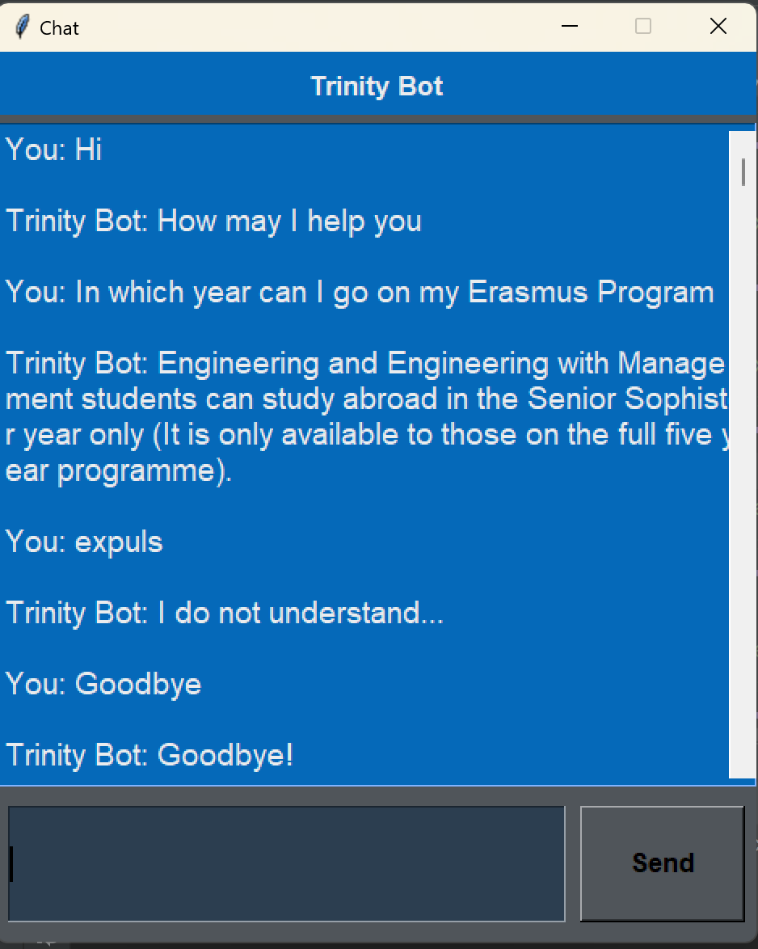
Introduction
Python Prototyping
Feasibility Study
Google Dialogflow
Benchmarking & Future Work
Initial Python Prototype (FAQ)
Intents JSON file that is Integrated in Google Dialogflow
Chatbot Prototype using Python

Slide 10

Google Dialogflow (AI Chatbot)
Introduction
Python Prototyping
Feasibility Study
Google Dialogflow
Benchmarking & Future Work
Utilizes Googles powerful natural language understanding engine
Easy to scale and integrate with websites, Facebook messenger, etc
Provides Rich Text options: Buttons, Hyperlink to websites for user experience
Records the interaction for training the agent

Slide 11
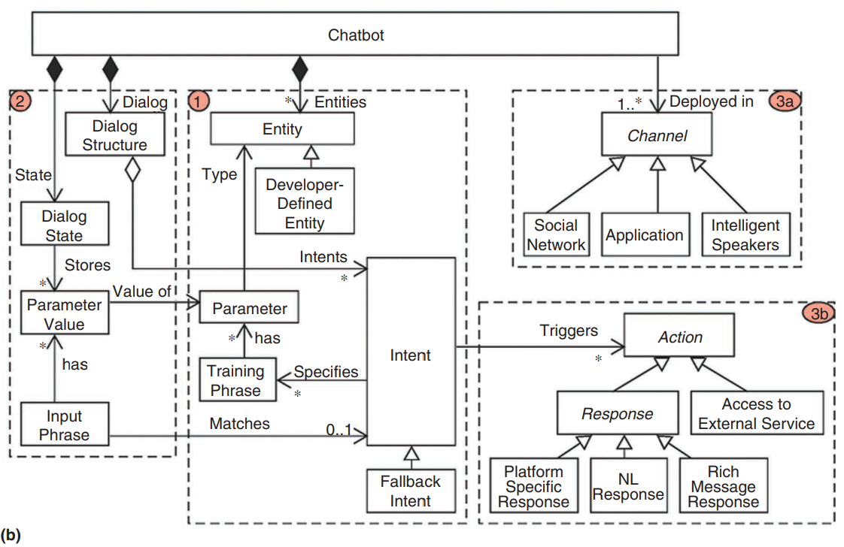
Technical Architecture of Dialogflow Agent
Introduction
Python Prototyping
Feasibility Study
Google Dialogflow
Benchmarking & Future Work
Integration Block
2
Query and Dialog Block
3
Response Block
1
Intent Block
Dialogflow Architecture
Source: Pérez-Soler, Sara & Juarez-Puerta, Sandra & Guerra, Esther & Lara, Juan. (2021). Choosing a Chatbot Development Tool. IEEE Software. PP. 10.1109/MS.2020.3030198.

Slide 12
Introduction
Python Prototyping
Feasibility Study
Google Dialogflow
Benchmarking & Future Work
Welcome Intent
Prospective Students
Goodbye Intent
Current Students
Undergraduate
Postgraduate
Undergraduate
Postgraduate
Courses
International Admissions
Outgoing (UNITECH, Erasmus, etc)
About Us (Contact Info, Transcripts)
Postgraduate Taught
Incoming (Erasmus, Non-EU, Contacts
Postgraduate Research
Micro-credentials
About Us (Contact info, Transcripts)
International Admissions
Careers, Scholarship, Etc.
Careers, Scholarships, Fees, Etc.
Engineering
Engineering with Management
Environmental Science and Engineering
Foundation Scholarship, Transcripts
Taught, Diplomas Research
Default Fallback Intent
Contact Information
Knowledge Base (FAQ)
Conversational Flow Architecture of Chatbot
2
1
3

Slide 13
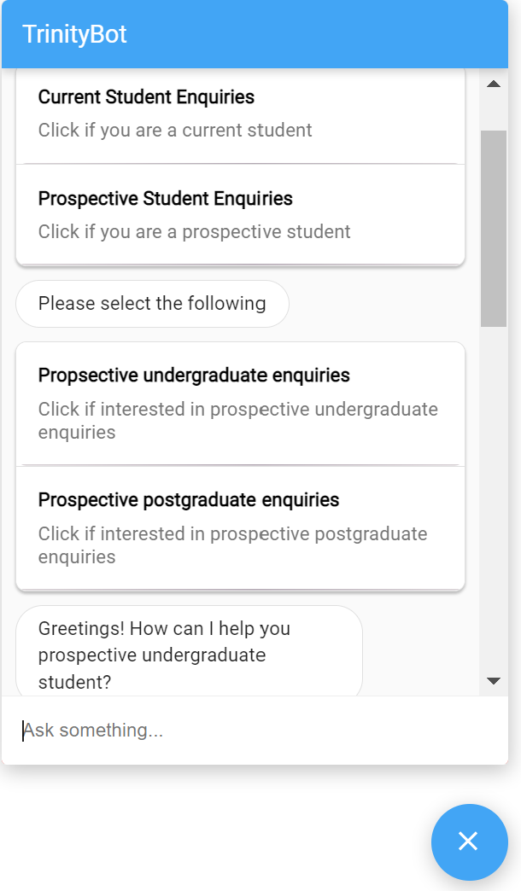
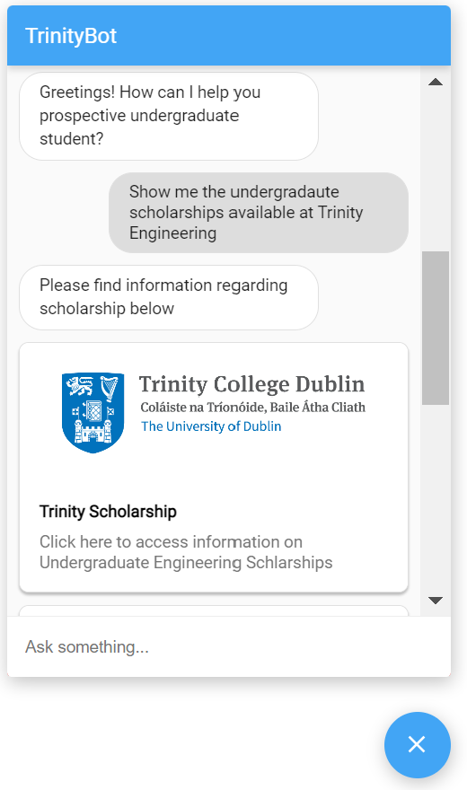
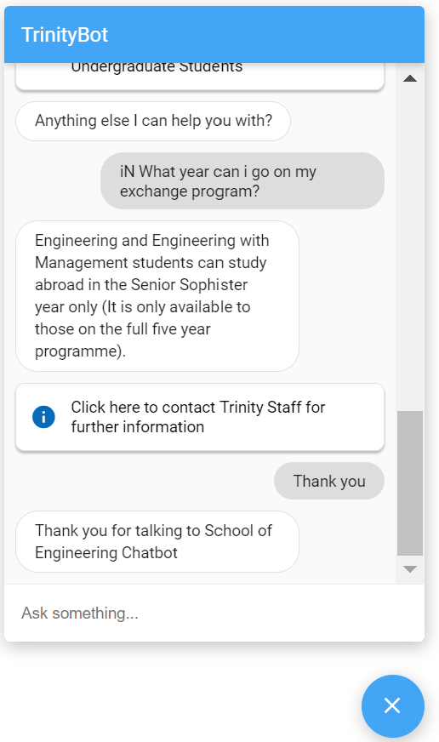
Introduction
Python Prototyping
Feasibility Study
Google Dialogflow
Benchmarking & Future Work
Conversational Flow of the AI Chatbot
Filters students into respective requirements
Trinity images (User experience)
Hyperlink to Trinity Webpages
Grammatical Errors
Obtained from FAQ Section (Python Prototype)
Snippets of a conversation with Trinity Bot that is integrated to the webpage

Slide 14
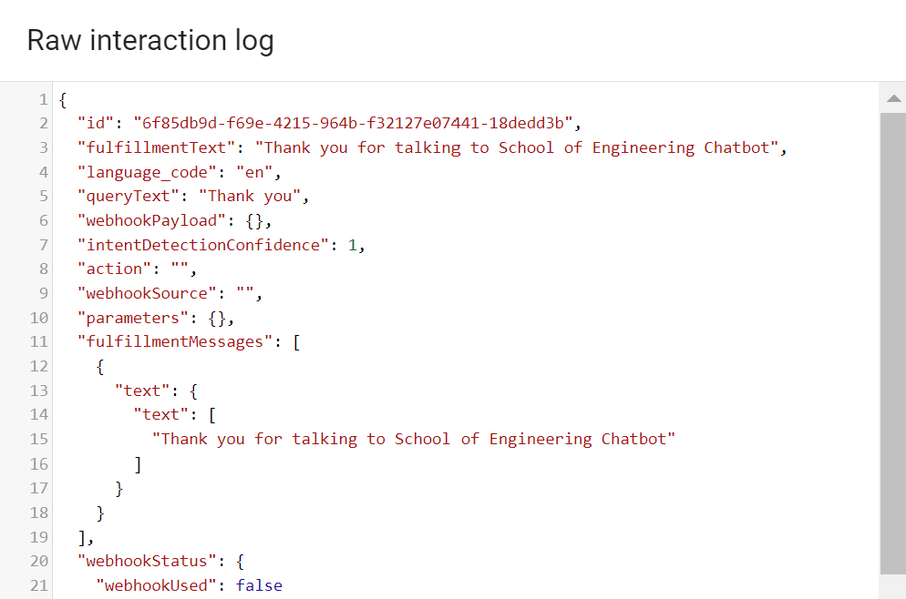
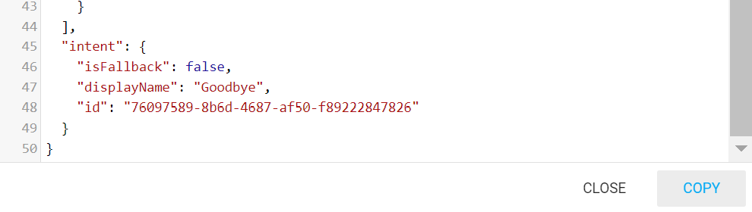
Introduction
Python Prototyping
Feasibility Study
Google Dialogflow
Benchmarking & Future Work
Results, Testing and Benchmarking
The chatbot is given access to the key stakeholders
Raw interaction log is obtained from Dialogflow, which states the intent matched for a query
The expected/predicted intents are recorded via spreadsheet
1
2
3

Slide 15
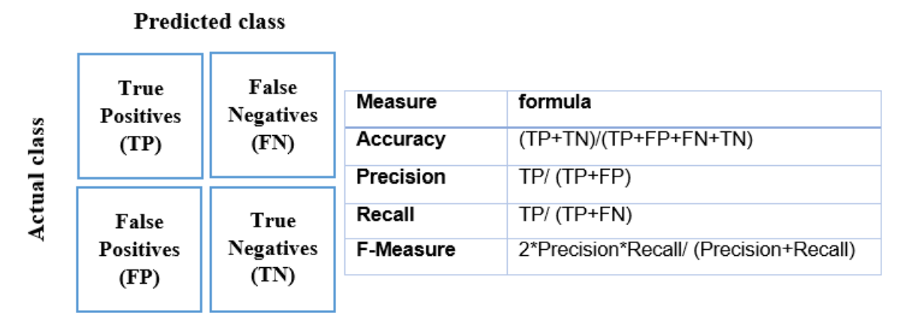
Introduction
Python Prototyping
Feasibility Study
Google Dialogflow
Benchmarking & Future Work
Results, Testing and Benchmarking
The intent matching confusion matrix is constructed to calculate the Precision, Recall and F1
F1 score is a machine learning evaluation metric that measures a model's accuracy and ranges from 0-1 (0 – Poor, 1- Good)
Reference: Sossi Alaoui, Safae & Farhaoui, Yousef & Aksasse, B.. (2018). Classification algorithms in Data Mining. International Journal of Tomography and Simulation. 31. 34-44.

Slide 16
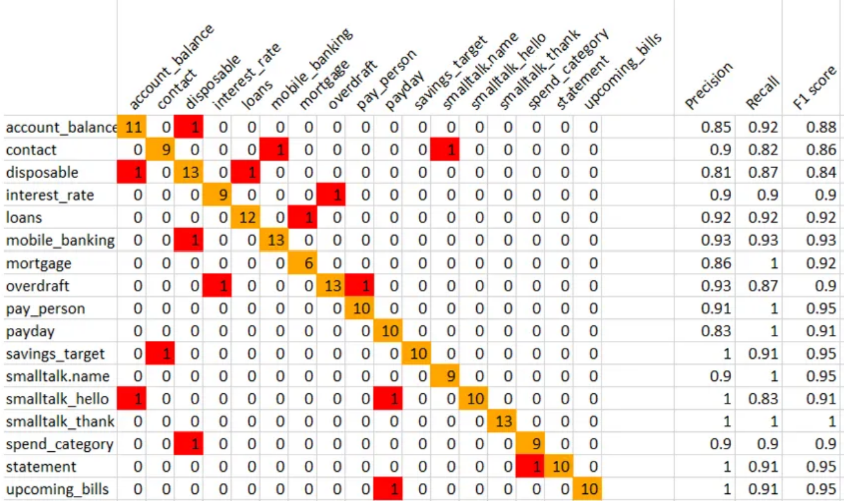
Introduction
Python Prototyping
Feasibility Study
Google Dialogflow
Benchmarking & Future Work
Results, Testing and Benchmarking
Predicted Intents
Expected Intents
Intent Confusion Matrix Example
Reference: https://chatbotsmagazine.com/automatically-generate-a-precision-recall-and-a-confusion-matrix-for-your-nlp-chatbot-training-9c2a8dc37752

Slide 17
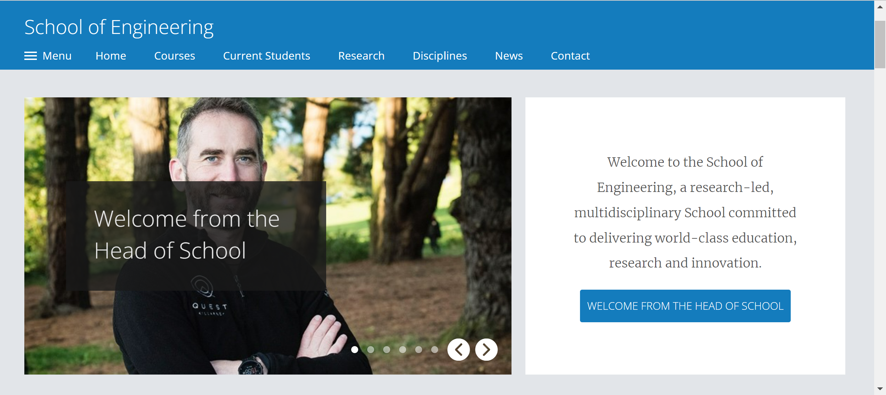
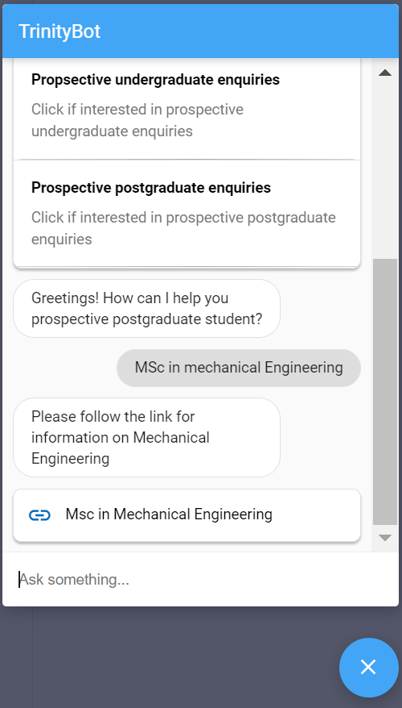
Introduction
Python Prototyping
Feasibility Study
Google Dialogflow
Benchmarking & Future Work
Future Work
Here is what the Conversational Agent could look like upon integration with the School of Engineering, Trinity website.

Slide 18
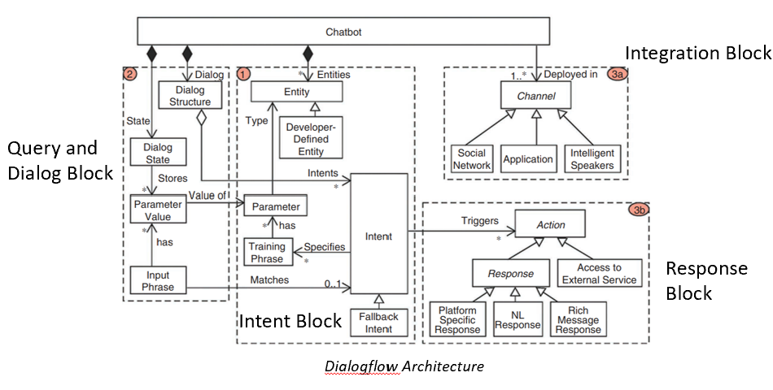
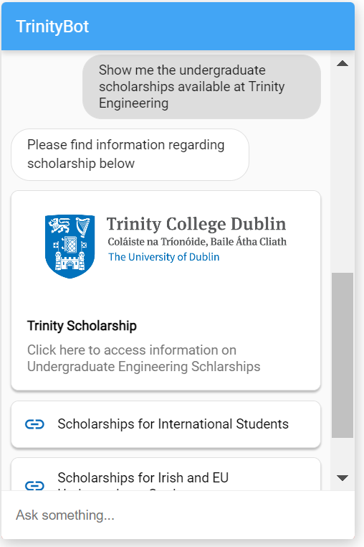
Thank You! Any Questions?

